Slide 1
FINCIRCLE: Community Chit Fund

Slide 2
Agenda
Team and Mentor Details
Problem Statement
Skills Learned
Use Cases
Technology Stack
Functional Requirements
Non - Functional Requirements
Solutions
Future Roadmap

Slide 3

TEAM
Diya Anna Sunil Developer 1 – Software Engineering
Shiny Fedora Arul Kumar Developer 1 – Software Engineering
Tona Antony Developer 1 – Software Engineering

Slide 4

MENTOR
Mr. SHARATH KUMAR
Corporate Trainer UST

Slide 5
SKILLS LEARNED
JAVA
SPRINGBOOT
HTML
CSS
JAVASCRIPT
TYPESCRIPT
ANGULAR
AWS
SPRING SECURITY

Slide 6
PROBLEM STATEMENT
The traditional chit fund system lacks transparency, secure transaction tracking, and efficient participant management, leading to trust issues and operational challenges. To address these, a digital chit fund management system is needed to automate processes, enhance security, and improve user experience through real-time tracking and AI-powered assistance.

Slide 7
USE CASES
User Registration & Authentication – Users sign up, log in, and manage profiles securely.
Group Creation & Management – Organizers create, manage, and track chit fund groups.
Join Requests & Participant Management – Users request to join groups, and organizers approve/reject requests.
Monthly Bidding & Winner Selection – Automated bidding system determines monthly winners.
Transaction Logging & Fund Tracking – Secure recording of contributions, payouts, and real-time balance tracking.
AI Chatbot Assistance – Provides user support, bidding insights, and chit fund information.

Slide 8



TECHNOLOGY STACK
FRONT-END
Angular 17 with TypeScript
BACK-END
Spring Boot for REST APIs
MySQL for storing data
JWT for authentication and Role based authorization.

Slide 9
FUNCTIONAL REQUIREMENTS
User Management – Users can register, log in, and manage their profiles.
Group Management – Organizers can create, update, and delete chit fund groups.
Join Requests & Approvals – Users can request to join a group, and organizers can approve requests.
Participant Tracking – Maintain a list of participants, their contributions, and bidding history.

Slide 10
FUNCTIONAL REQUIREMENTS
Chit Plan Calculation – Automate monthly bidding, winner selection, and distribution of funds.
Transaction Logging – Record all payments, withdrawals, and transactions securely.
AI Chatbot Assistance – Provide real-time guidance and support using an AI-powered chatbot.
Security & Authentication – Implement role-based access control for secure operations.

Slide 11
NON - FUNCTIONAL REQUIREMENTS
Scalability – Support multiple chit fund groups and growing user participation.
Performance – Ensure quick response times for transactions and AI interactions.
Security – Use encryption and authentication to protect sensitive data.
Availability – Maintain high uptime for continuous access.
Usability – Provide an intuitive and user-friendly interface.
Maintainability – Ensure easy updates and modifications.
Reliability – Guarantee accurate transaction handling and data consistency.

Slide 12
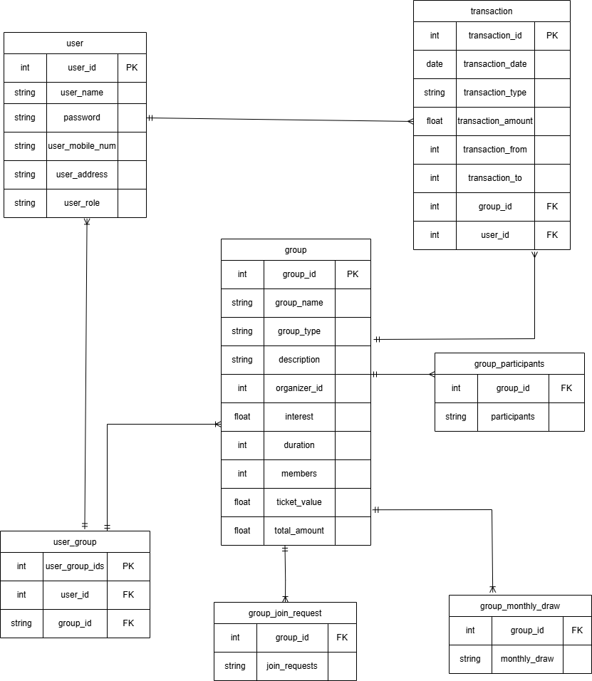
ER DIAGRAM

Slide 13
SOLUTIONS
User Management
Secure registration, authentication and role-based access control.
Group
Management
Seamless creation, participation and management of chit fund groups.
Transaction Management
Secure logging of contributions, payouts and real-time tracking.
AI Chatbot
Smart assistance for user queries and bidding insights.

Slide 14
DEMO

Slide 15



FUTURE ROADMAP
NOTIFICATIONS
MOBILE APPLICATION
PAYMENT

Slide 16
Thank you

